Slide 1

Team Name : NeuroVision
Team Leader Name : Shravani R S
Problem Statement : AI for Healthcare & Life Sciences
(NeuroScan AI - Predicting Strokes & Dementia Years Before)

Slide 2

Brief about the Idea:
NeuroScan AI - Predicting Strokes & Dementia Years Before Symptoms Appear
THE PROBLEM:
India: 1.8 million strokes annually (75% preventable)
Rural areas: 1 neurologist per 250,000 people
Current diagnosis: Reactive (after symptoms appear)
Hidden information: Brain MRI contains predictive biomarkers invisible to radiologists
THE OPPORTUNITY:
Research proves: Brain changes appear 5-10 years before stroke/dementia
Technology gap: Breakthrough AI stuck in research labs, not reaching rural India
Cost barrier: Traditional neurological screening costs ₹15,000+
OUR SOLUTION:
NeuroScan AI analyzes brain MRI scans using deep learning to predict stroke and dementia risk years in advance, making advanced neurology accessible to 25,000 Primary Health Centers across India at ₹200 per screening.

Slide 3
How It's Different:
Existing Solutions | NeuroScan AI
Focus on single conditions | 7 comprehensive assessments in one scan
Black-box AI with no explanations | Visual explanations showing brain regions at risk
Cost ₹2,000+ per consultation | ₹200 per screening - 90% cost reduction
Require stable internet connectivity | Offline report viewing for poor connectivity
English-only interfaces | Multi-language support - Hindi & regional languages
Desktop-dependent systems | WhatsApp sharing for rural accessibility
Our USP:
      The only AI solution combining comprehensive multi-condition brain analysis, visual explainability, and rural-first design at the cost of a basic health checkup.

Slide 4
List of features offered by the solution:
7 AI-Powered Assessments:
Brain Age Estimation - Detects accelerated brain aging
White Matter Disease Detection - Identifies vascular damage
Silent Stroke Identification - Finds unnoticed micro-strokes
Brain Atrophy Analysis - Measures brain shrinkage
Microbleed Detection - Spots tiny hemorrhages
Stroke Risk Prediction - 5-year and 10-year probabilities
Dementia Risk Assessment - Alzheimer's and vascular dementia
Patient-Centric Features:
Under 2 minutes total processing time
Visual heatmaps showing affected brain regions
Dual reports - Technical for doctors, simple for patients
Percentile rankings compared to age-matched population
Actionable recommendations for risk reduction
Multi-language support for patient understanding
WhatsApp/Email/PDF sharing for easy distribution
Offline viewing for areas with poor connectivity

Slide 5
Process Flow Diagram
FRONTEND LAYER
React Web App (PWA) + Mobile Interface
AWS API GATEWAY
Authentication (Cognito)
PROCESSING LAYER
Lambda MRI Preprocessing
Functions (FSL + ANTs)
AI MODELS
Brain Age Multi-Task Model
(ResNet50) (U-Net + ResNet)
STORAGE LAYER
S3 (MRI) | DynamoDB (Results) | RDS
REPORTING LAYER
Bedrock (Claude) + Explainability

Slide 6
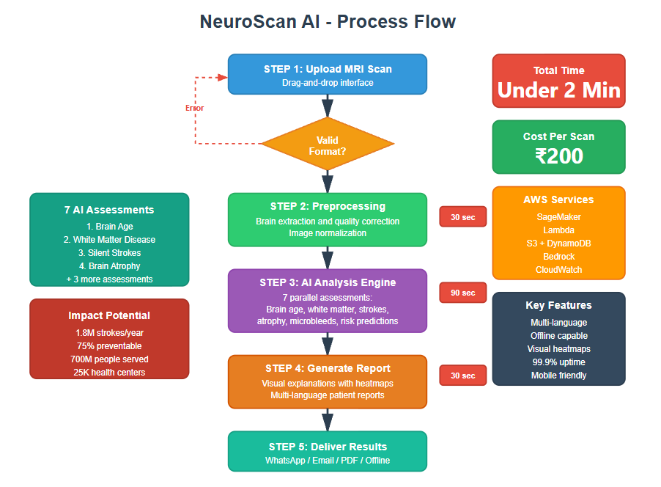
Process flow diagram or Use-case diagram:

Slide 7
Architecture diagram of the proposed solution:
Cloud-Native Healthcare Platform
Frontend Layer:
React Progressive Web App with offline capability
Mobile and tablet responsive design
API & Security:
AWS API Gateway for routing
AWS Cognito for authentication
AES-256 encryption
Processing Engine:
AWS Lambda for orchestration
AWS SageMaker for AI inference
FSL and ANTs for MRI preprocessing
AI Models:
3D ResNet50 for brain age
3D U-Net for lesion detection
Ensemble models for risk calculation
Storage:
Amazon S3 for encrypted MRI storage
DynamoDB for fast metadata access
RDS for user and audit data
Reporting:
AWS Bedrock for multi-language reports
Grad-CAM for visual explanations
Monitoring:
CloudWatch for system health
Auto-scaling for 1000+ concurrent scans

Slide 8
Technologies to be used in the solution:
AI & Machine Learning:
PyTorch - Deep learning framework for 3D CNNs
3D ResNet50 - Feature extraction backbone
3D U-Net - Lesion segmentation architecture
Grad-CAM - Explainability visualizations
Ensemble Models - Risk calculation combining multiple approaches
Medical Image Processing:
FSL (FMRIB Software Library) - Brain extraction and registration
ANTs (Advanced Normalization Tools) - Image normalization
DICOM & NIfTI - Medical imaging format support
SimpleITK - Image processing operations
AWS Cloud Services:
Amazon SageMaker - AI model hosting and inference
AWS Lambda - Serverless processing orchestration
Amazon S3 - Encrypted medical data storage
Amazon DynamoDB - Fast metadata database
Amazon RDS - Relational data for users and audits
AWS API Gateway - RESTful API management
AWS Cognito - User authentication
Amazon Bedrock - Natural language report generation
CloudWatch - Monitoring and logging
AWS KMS - Encryption key management
Frontend & Integration:
React 18 with TypeScript - Modern web framework
Progressive Web App (PWA) - Offline capabilities
Tailwind CSS - Responsive design
Chart.js - Data visualizations
HL7 FHIR - Healthcare data standards
DICOM Protocol - Medical imaging integration

Slide 9
Estimated implementation cost
PHASE 1 - HACKATHON PROTOTYPE (20 days):
AWS Credits (Student): $100 (FREE via AWS Educate)
Google Drive Storage: ₹650
Development: ₹0 (self-developed)
TOTAL: ₹650 (~$8)
PHASE 2 - CLINICAL VALIDATION (6 months):
AWS Infrastructure: ₹50,000/month × 6 = ₹3,00,000
Clinical Partnership (NIMHANS/AIIMS): ₹0 (collaboration)
Regulatory Compliance: ₹2,00,000
TOTAL: ₹5,00,000 (~$6,000)
PHASE 3 - PILOT DEPLOYMENT (Year 1):
100 PHCs × ₹10,000 setup = ₹10,00,000
AWS (1,000 scans/day): ₹5,00,000/year
Training & Support: ₹5,00,000
TOTAL: ₹20,00,000 (~$24,000)
OPERATIONAL COST PER SCAN:
AWS Processing: ₹150
Support & Maintenance: ₹50
TOTAL: ₹200 per scan
vs Traditional Screening: ₹15,000
ROI: 75x cost reduction

Slide 10
VISION
NeuroScan AI: Preventing Strokes Across India
Our Mission: Making expert neurological screening accessible to every Indian through AI and cloud computing.
The Impact:
Prevent 1.8 million strokes annually
Save ₹3,750+ crores in healthcare costs
Empower 25,000 Primary Health Centers
Serve 700 million underserved rural Indians
Why This Matters: Every 40 seconds, someone in India has a stroke. With NeuroScan AI, we identify risk years early and save lives.

Slide 11
Add as per the requirements for the hackathon:
We use 3D convolutional neural networks for pattern recognition in brain MRI scans. This cannot be done with rule-based systems because the patterns are too complex and exist across billions of voxels in 3D space.
Why AI is Essential:
Radiologists miss 60 to 70 percent of subtle early warning signs that predict stroke 5 to 10 years in advance. AI can analyze the entire 3D brain volume comprehensively in ways humans cannot.
AWS Services Integration:
SageMaker - AI model training and real-time deployment
Lambda - Serverless preprocessing automation
S3 - Encrypted medical image storage
Bedrock with Claude - Natural language report generation
DynamoDB - Fast results storage and retrieval
Cognito - Secure user authentication
Responsible AI Design:
Explainable predictions with visual heatmaps showing reasoning
Human-in-the-loop - AI assists, doctors make final decisions
Privacy-compliant with encryption and de-identification
Tested across diverse populations to reduce bias
Clear communication when system is uncertain
Training Data:
Public research datasets from OASIS, ADNI, and IXI containing over 13,000 brain scans. No private patient data used in development

Slide 12


